Slide 1
Welcome! Database Development and Design
Developing and Design of databases using SQL Server

Slide 2
Agenda
Session 1
Session 2
Session 3
Homework discussion
Built-In functions
Workshop
Grouping functions
Aggregate functions (Min, Max, Sum, Avg, Count)
Workshop
Filtering by grouped data
Workshop
Views
Workshop
Knowledge check (Quiz, Discussion, Homework)
Session 4
Session 5

Slide 3
Homework discussion

Slide 4
Built-In functions

Slide 5
Built-In functions - Declarations
Scalar variable
Table variable
Temp table
DECLARE @EmployeeId INT
SET @EmployeeId = 1
DECLARE @EmployeeList TABLE
(EmployeeId int, FirstName NVARCHAR(100), LastName NVARCHAR(100));
INSERT INTO @EmployeeList
SELECT Id, FirstName, LastName from dbo.Employee
CREATE TABLE #EmployeeList
(EmployeeId int, FirstName NVARCHAR(100), LastName NVARCHAR(100));
INSERT INTO #EmployeeList
SELECT Id, FirstName, LastName from dbo.Employee

Slide 6
Built-In functions – String functions
LEFT(), RIGHT(), LEN()
SUBSTRING
SUBSTRING ( expression ,start , length )
REPLACE
REPLACE ( string_expression , string_pattern , string_replacement )
Example:
select FirstName,
LEFT(FirstName,3) as LeftFunction,
RIGHT(FirstName,3) as RightFunction,
LEN(FirstName) as LenFunction,
SUBSTRING(FirstName,1,3) as SubstringFunction,
REPLACE(FirstName,'Ale','X-') as ReplaceFunction
from dbo.Employee

Slide 7
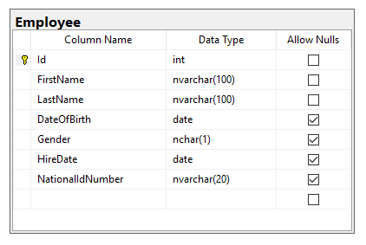
Built-in functions - Workshop
Declare scalar variable for storing FirstName values
Assign value ‘Aleksandar’ to the FirstName variable
Find all Employees having FirstName same as the variable
Declare table variable that will contain EmployeeId and DateOfBirth
Fill the table variable with all Female employees
Declare temp table that will contain LastName and HireDate columns
Fill the temp table with all Male employees having First Name starting with ‘A’
Retrieve the employees from the table which last name is with 7 characters

Slide 8
Grouping functions
Min, Max, Sum, Avg, Count, String_agg

Slide 9
Grouping functions
With grouped queries, you can arrange the rows you’re querying in groups and apply data analysis computations like aggregate functions against those groups.
A query becomes a grouped query when you use a group function, a GROUP BY clause, or both.
A query that invokes a group function but doesn’t have an explicit GROUP BY clause arranges all rows in one group. Consider the following query as an example:
SELECT COUNT(*) as Total
FROM dbo.Employee
SELECT Gender, COUNT(*) as Total
FROM dbo.Employee
GROUP BY Gender

Slide 10
Grouping functions
Numeric aggregation functions
COUNT
SUM
AVG
MIN
MAX
String aggregation functions
STRING_AGG

Slide 11
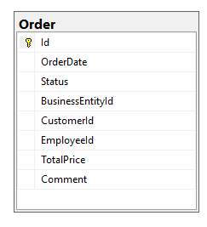
Grouping functions - Workshop
Calculate the total amount on all orders in the system
Calculate the total amount per BusinessEntity on all orders in the system
Calculate the total amount per BusinessEntity on all orders in the system from Customers with ID < 20
Find the Maximal Order amount, and the Average Order amount per BusinessEntity on all orders in the system
Suggest a question about some information that needs to be extracted from the Orders table

Slide 12
Filtering by grouped data
HAVING operator

Slide 13
Grouping functions – filtering by grouped data
Many often we need to perform search operations on already aggregated data
WHERE expression filter the resultset before grouping
HAVING operator is used to filter data after grouping
example:
SELECT Column1, fn(ColumnN)
FROM Table1
WHERE ColumnN condition
GROUP BY Column1
HAVING fn(ColumnN) condition
SELECT BusinessEntityId, SUM(TotalPrice) as Total
FROM dbo.[Order]
WHERE CustomerId < 20
GROUP BY BusinessEntityId
HAVING SUM(TotalPrice) > 628920

Slide 14
Grouping functions filtering - Workshop
Calculate the total amount per BusinessEntity on all orders in the system and filter only total orders greater then 635558
Calculate the total amount per BusinessEntity on all orders in the system from Customers with ID < 20 and filter only total orders less then 100000
Find the Maximal Order amount, and the Average Order amount per BusinessEntity on all orders in the system. Filter only records where Total order amount is more then 4x bigger then average
List all BusinessEntity names next to the other details from the previous query
Suggest a question about some information that needs to be extracted from the Orders table

Slide 15
Views

Slide 16
View definition
With views you can present the contents of one or more base data tables to users, and you can encapsulate complex logic such as joins and filters so that the user does not need to remember them.
To create a view, you name the view and then specify the SELECT statement that will constitute the view.
Syntax:
Example:
CREATE VIEW [ViewName]
AS
SELECT Column1,Column2,...ColumnN
FROM [TableName]
CREATE VIEW MaleEmployees
AS
SELECT Id,FirstName,LastName,HireDate
FROM dbo.Employee
WHERE Gender = 'M'

Slide 17
View additional settings
WITH SCHEMABINDING – option guarantees that the underlying table structures cannot be altered without dropping the view
To create a view, you name the view and then specify the SELECT statement that will constitute the view.
Example:
CREATE VIEW MaleEmployees
WITH SCHEMABINDING
AS
SELECT Id, FirstName,LastName,HireDate
FROM dbo.Employee
WHERE Gender = 'M'

Slide 18
Indexed View
View is just a definition by a SELECT statement of how the results should be built - no data is stored
It is possible to create view that will keep copy of the data included in the view – it is called indexed view
Reasons for indexing view:
Improve performance of the query
Limitations:
T-SQL can’t contain COUNT, MIN, MAX, TOP, outer joins
How to index the view:
CREATE UNIQUE CLUSTERED INDEX ix_MaleEmployees
ON MaleEmployees(Id)

Slide 19
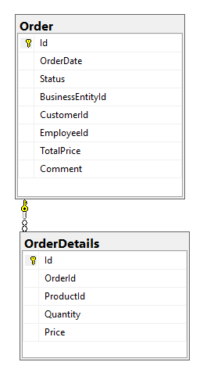
Views - Workshop
Create new view (vv_CustomerOrders) that will List all CustomerIds and sum of total Orders per customer
Change the view to show Customer Names instead of CustomerId
Change the view to show the results ordered by the customer with biggest total price
Create new view (vv_EmployeeOrders) that will List all Employees (FirstName and LastName) , Product name and total quantity sold
Alter the view to show only sales from Business entities belonging to region 'Skopski'
Suggest a question about some information that needs to be extracted from the Order details table

Slide 20
Knowledge check
Quiz, Discussion, Homework

Slide 21
Quiz
Can we assign multiple values to scalar variable?
a. Yes
b. No
Can we have WHERE operator in the same statement with GROUP BY operator?
a. Yes
b. No
Which SQL function is used to determine number of characters in the string?
a. LEFT
b. STRING
c. STRING_SIZE
d. LEN
Which SQL function is used to concatenate multiple string records into single value?
a. AGG
b. CONCAT
c. STRING_AGG
d. MERGE

Slide 22
Quiz
Can we group data from multiple records without using GROUP BY function?
a. Yes
b. No
Which operator is used to filter the resultset by the result of aggregate function?
a. FILTER
b. CHECK
c. WHERE
d. HAVING
Can we have ORDER BY and HAVING operator in the same statement?
a. Yes
b. No

Slide 23
Quiz
What is the main difference between View and Indexed View?
What is the purpose of SCHEMABINDING option in View creation?

Slide 24
Homework

Slide 25
Homework requirement 1/4
Declare scalar variable for storing FirstName values
Assign value 'Antonio' to the FirstName variable
Find all Students having FirstName same as the variable
Declare table variable @StudentList that will contain StudentId, FirstName and DateOfBirth
Fill the table variable with all Female students
List all Students from table variable
List all Students from table variable younger than 1992-02-22
Declare temp table #StudentList that will contain LastName and EnrolledDate columns
Fill the temp table with all Male students having First Name starting with ‘A’
List all Students from temp table who have Last Name with length greater than 5

Slide 26
Homework requirement 2/4
Calculate the count of all grades in the system
Calculate the count of all grades per Teacher in the system
Calculate the count of all grades per Teacher in the system for first 100 Students (ID < 100)
Find the Maximal Grade, and the Average Grade per Student on all grades in the system

Slide 27
Homework requirement 3/4
Calculate the count of all grades per Teacher in the system and filter only grade count greater then 200
Calculate the count of all grades per Teacher in the system for first 100 Students (ID < 100) and filter teachers with more than 50 Grade count
Find the Grade Count, Maximal Grade, and the Average Grade per Student on all grades in the system. Filter only records where Maximal Grade is equal to Average Grade
List Student First Name and Last Name next to the other details from previous query

Slide 28
Homework requirement 4/4
Create new view (vv_StudentGrades) that will List all StudentIds and count of Grades per student
Change the view to show Student First and Last Names instead of StudentID
List all rows from view ordered by biggest Grade Count
Create new view (vv_StudentGradeDetails) that will List all Students (FirstName and LastName) and Count the courses he passed through the exam(Ispit)

